Slide 1
Example Stateless Session EJB

Slide 2
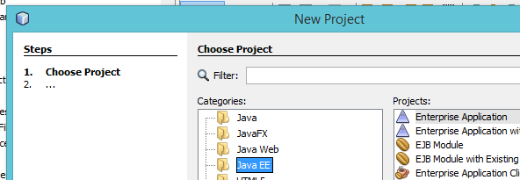
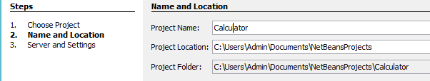
Create new project : java jee

Slide 3
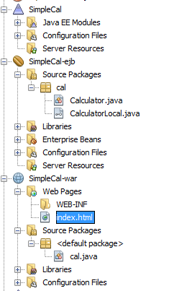
Create form
<html>
<head>
<title>TODO supply a title</title>
<meta charset="UTF-8">
<meta name="viewport" content="width=device-width, initial-scale=1.0">
</head>
<body>
<form action="cal">
num1 <input type="text" name="N1"><br>
num 2 <input type="text" name="N2"><br>
<input type="submit">
</form>
</body>
</html>

Slide 4
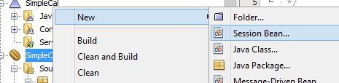
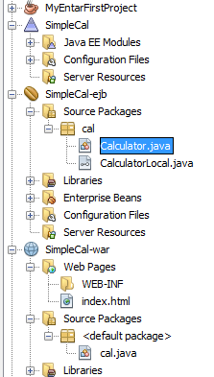
Create bean
package cal;
import javax.ejb.Stateless;
@Stateless
public class Calculator implements CalculatorLocal {
@Override
public int add(int n1, int n2){
int a;
a=n1+n2;
return a;
}

Slide 5
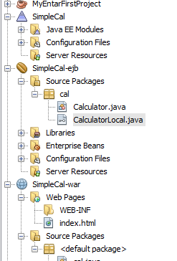
Update local file also
package cal;
import javax.ejb.Local;
@Local
public interface CalculatorLocal {
public int add(int n1, int n2);
}

Slide 6
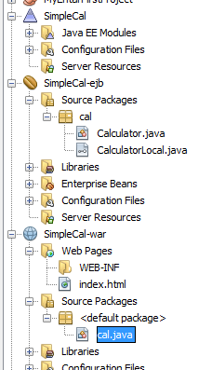
Crate servlet page
protected void processRequest(HttpServletRequest request, HttpServletResponse response)
throws ServletException, IOException {
response.setContentType("text/html;charset=UTF-8");
int n1=Integer.parseInt(request.getParameter("N1"));
int n2=Integer.parseInt(request.getParameter("N2"));
import cal.CalculatorLocal;
import java.io.IOException;
import java.io.PrintWriter;
import javax.ejb.EJB;
import javax.servlet.ServletException;
import javax.servlet.annotation.WebServlet;
import javax.servlet.http.HttpServlet;
import javax.servlet.http.HttpServletRequest;
import javax.servlet.http.HttpServletResponse;
@WebServlet(urlPatterns = {"/cal"})
public class cal extends HttpServlet {
@EJB
private CalculatorLocal calculator;
try (PrintWriter out = response.getWriter()) {
out.println("<!DOCTYPE html>");
out.println("<html>");
out.println("<head>");
out.println("<title>Servlet cal</title>");
out.println("</head>");
out.println("<body>");
out.println("<h1>Addtion of 2 numbers= " +calculator.add(n1,n2) + "</h1>");
out.println("</body>");
out.println("</html>");
}
}

